Slide 1

Customer Segmentation Project
By Nguyen Le

Slide 2

CONTENT
INTRODUCTION
INPUT AND OUTPUT
DATASET
PREPROCESSING
MODELING AND OPTIMIZING
CONCLUSION

Slide 3
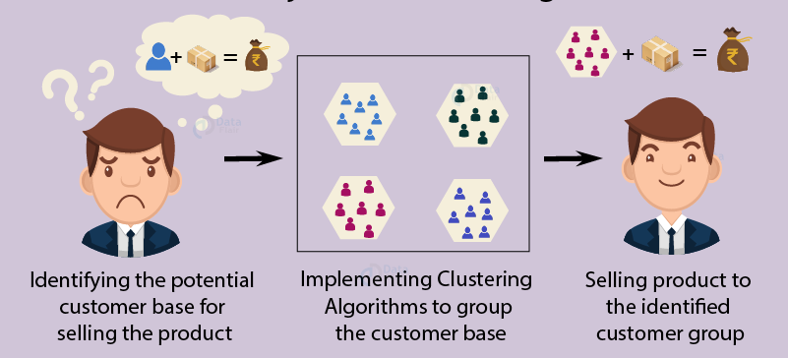
1. INTRODUCTION
Problem statement
Customer Segmentation is a popular application of unsupervised learning. Using clustering techniques, companies can identify the several segments of customers allowing them to target the potential user base.
Customer Segmentation is the process of division of customer base into several groups of individuals that share a similarity in different ways that are relevant to marketing such as gender, age, interests, spending habits and saving.

Slide 4
2. INPUT - OUTPUT
Input:
CustomerID
Gender
Age
Annual Income
Spending Score
Out put:
Segmentation Groups

Slide 5
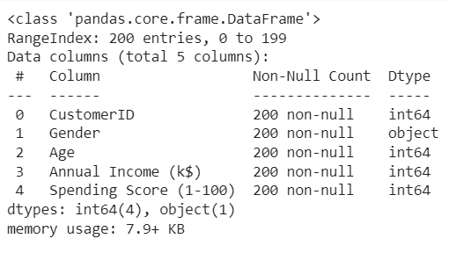
3. DATASET
The dataset (1 file) Mall_Customers.csv contains 5 columns
Dataset size: 200 rows * 5 columns
Gender is a categorical value and other features are numeric
No null value

Slide 6
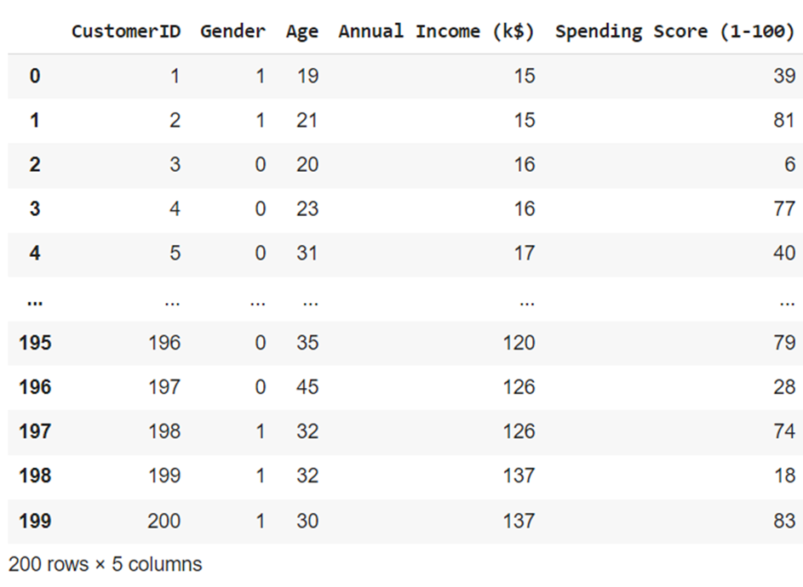
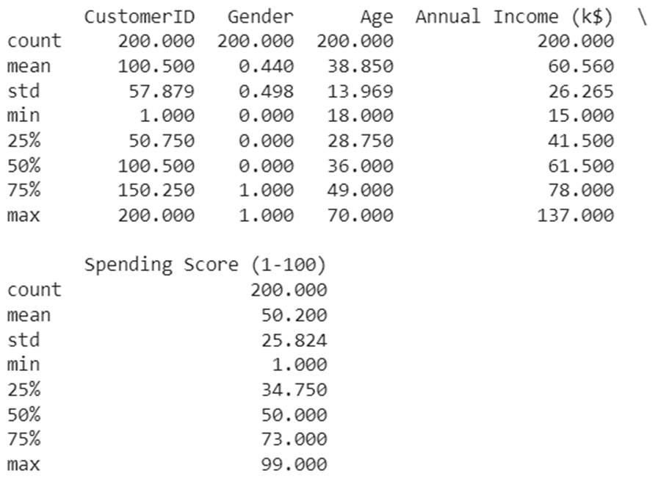
3. DATASET (Cont.)

Slide 7
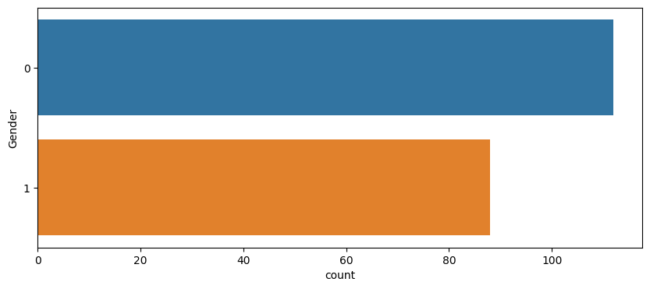
4. PREPROCESSING
Gender count for each group: 0 – Female, 1 - Male

Slide 8
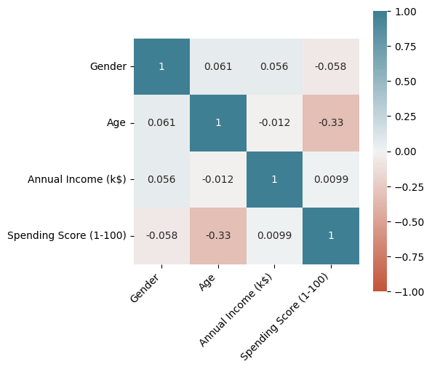
4. PREPROCESSING (Cont.)
Correlation matrix
There is no high correlation between features.

Slide 9
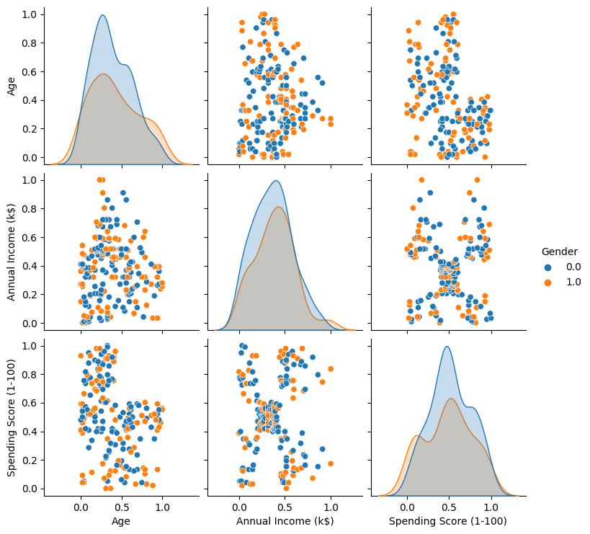
4. PREPROCESSING (Cont.)
Scatter Plot
7

Slide 10
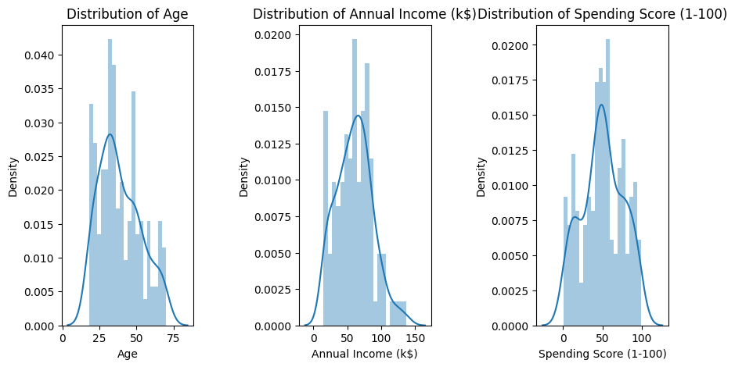
4. PREPROCESSING (Cont.)
Histogram

Slide 11
4. PREPROCESSING (Cont.)
Scatter Plot (after scaling)
9

Slide 12
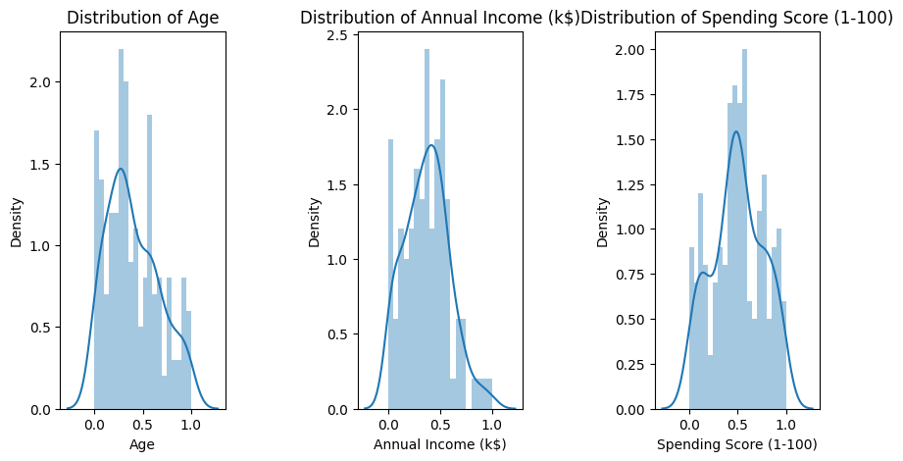
4. PREPROCESSING (Cont.)
Histogram (after scaling)

Slide 13
5. MODELLING & OPTIMIZING
Model type:
Kmeans
Cluster optimal methods:
Elbow method
Silhouette method

Slide 14
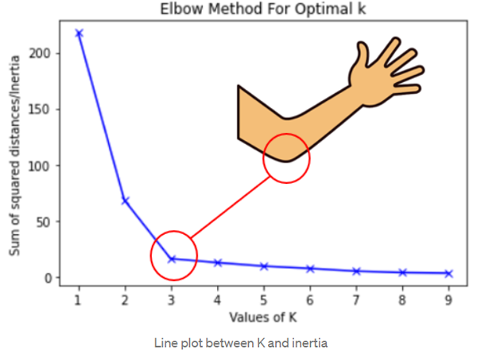
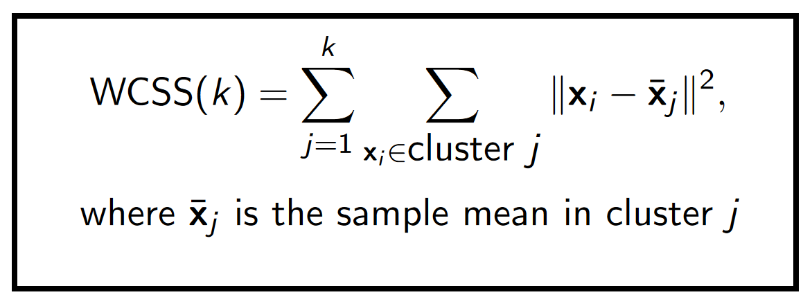
5.1 Elbow method
determine the number of centroids(k) to use in a k-means clustering algorithm.
continuously iterate for k=1 to k=n, calculate the within-cluster sum of squares (WCSS) value for each k.
WCSS - It is defined as the sum of square distances between the centroids and each points.

Slide 15
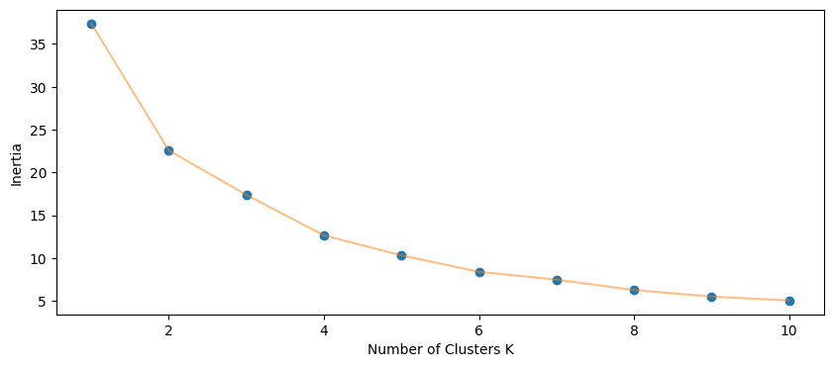
5.1 Elbow method
The optimal number of clusters is 4.

Slide 16
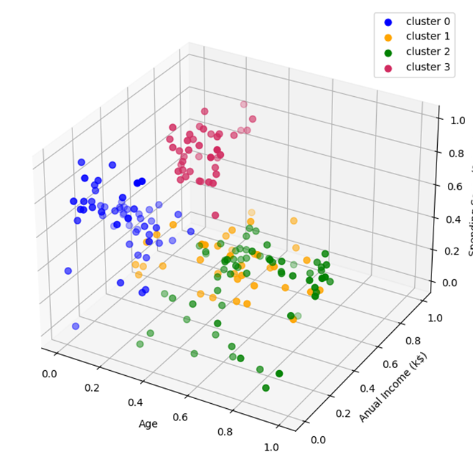
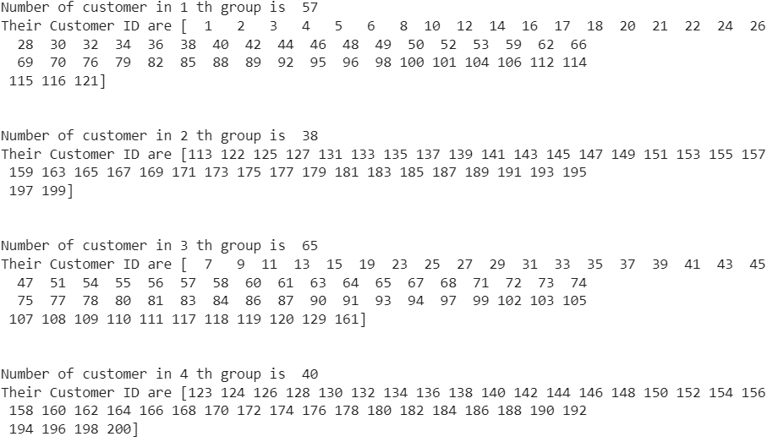
5.1 Elbow method
14
The list of customer ID in each cluster
6

Slide 17

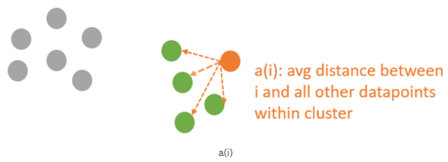
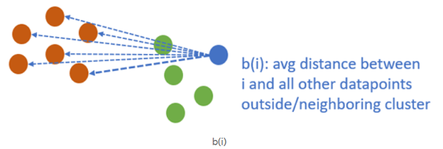
5.2 Silhouette method
Measure of how similar a data point is within-cluster (cohesion) compared to other clusters (separation)
The value of the Silhouette score ranges from -1 to 1.
1: Points are perfectly assigned in a cluster and clusters are easily distinguishable.
0: Clusters are overlapping.
-1: Points are wrongly assigned in a cluster.
The silhouette coefﬁcient for a particular data point
Then, calculate the average_silhouette for every k

Slide 18
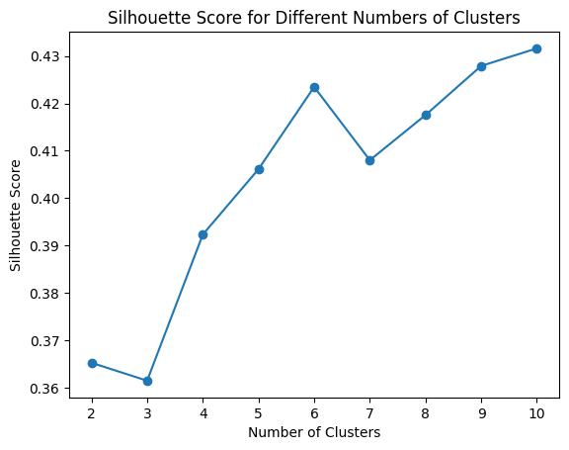
5.2 Silhouette method
The optimal number of clusters is 10.
16

Slide 19
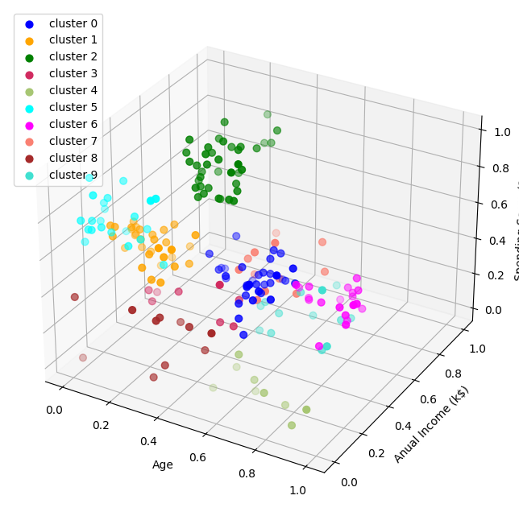
5.2 Silhouette method

Slide 20

CONCLUSION
Clustering analysis
Group 1 (cluster 0): wide range of income – wide range of spending – young age
Group 2 (cluster 1): medium to high income – low spending – small amount of young age customers
-> potential group > asking the feedback and advertising
Group 3 (cluster 2): from medium to high income - low spending – small amount old age customers
-> potential group > asking the feedback and advertising
Group 4 (cluster 3): high income – medium to high spending - young age -> the most potential group -> sending new product alerts

